Slide 1
ATAI
Advanced Technique of Artificial Intelligence
ATAI
ChongqingUniversity _{AdvancedTechniqueof}
of Technology Artificial Intelligence
Chongqing University of Technology
Chongqing University ^{ATAI}
_{of Technology} Advanced Techniqueof
Artificial Intelligence
Chongqing University of Technology
Chongqing University of Technology
Cross-modal Contrastive Learning for Multimodal Fake News Detection
Code:https://github.com/wishever/COOLANT
—— MM ’23
Reported by Shu Ming Jiang
1

Slide 2
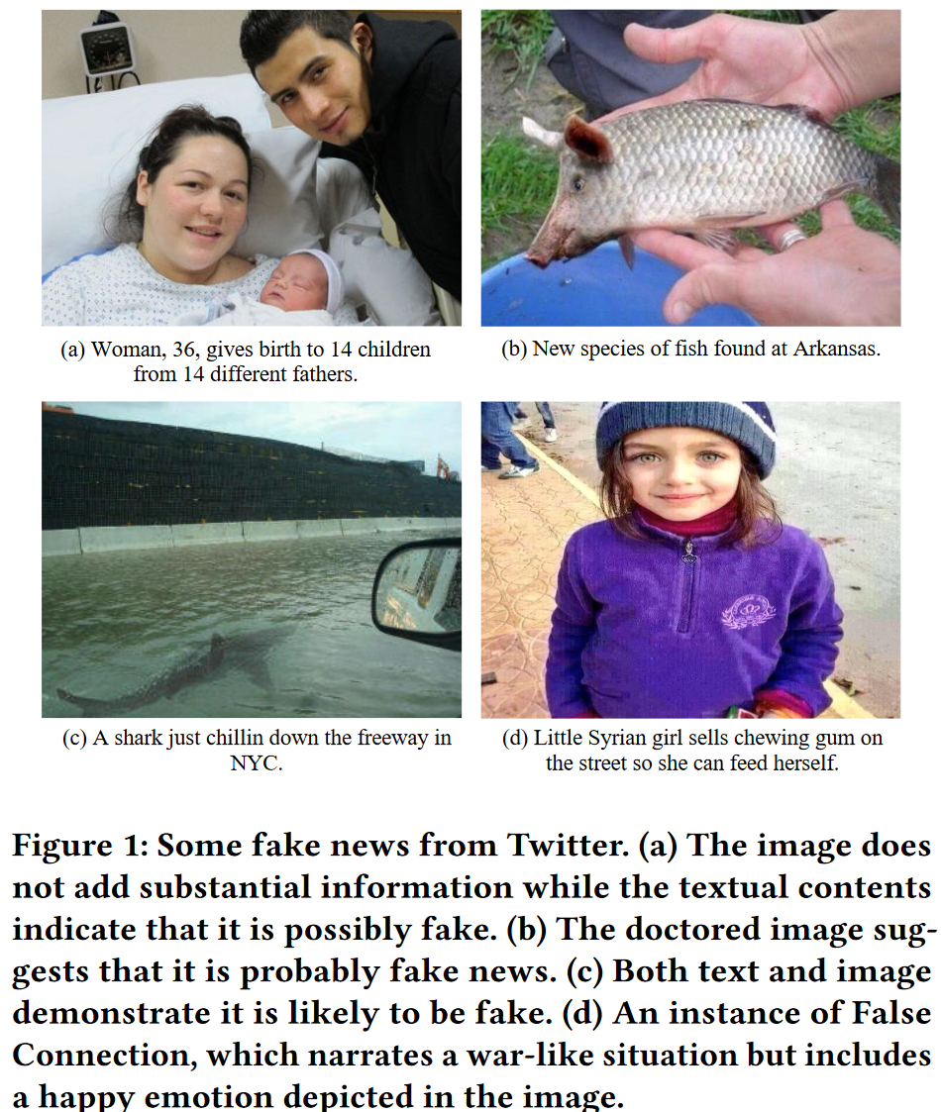
ATAI
Advanced Technique of
Artificial Intelligence
ATAI
ChongqingUniversity _{AdvancedTechniqueof}
of Technology Artificial Intelligence
Chongqing University of Technology
Introduction
(1)cross-modal features might not necessarily play a critical role in some cases . how features from different modalities affect the decision-making process and how we can make it more effective and interpretable remain open questions.
(2)A contrastive loss has been shown to be an effective objective for improving the unimodal encoders to better understand the semantic meaning of images and texts. While effective, the one-hot labels in contrastive learning penalize all negative predictions regardless of their correctness.Different image-text pairs may have potential correlation (especially in the case of different multimodal news about the same event)
contributions :
•We introduce an attention mechanism with an attention guidance module to help effectively and interpretably aggregate features from different modalities.
• We soften the loss term of negative samples during the contrast process to ease the strict constraint, so as to make it more compatible with our task.

Slide 3
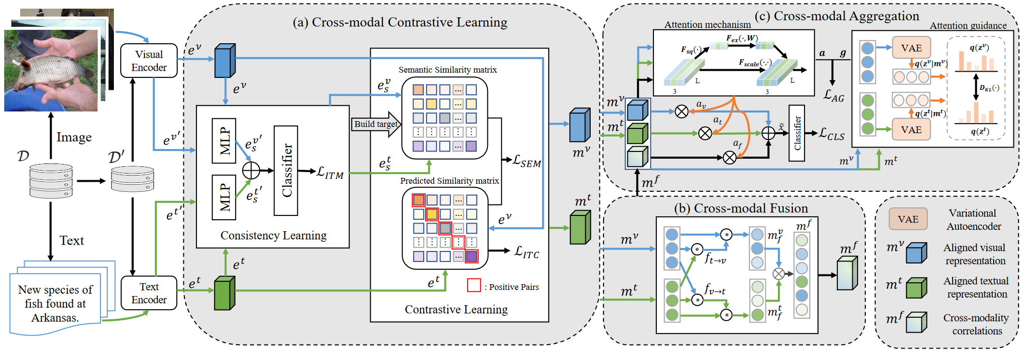
ATAI
Advanced Technique of
Artificial Intelligence
ATAI
ChongqingUniversity _{AdvancedTechniqueof}
of Technology Artificial Intelligence
Chongqing University of Technology
Overview

Slide 4
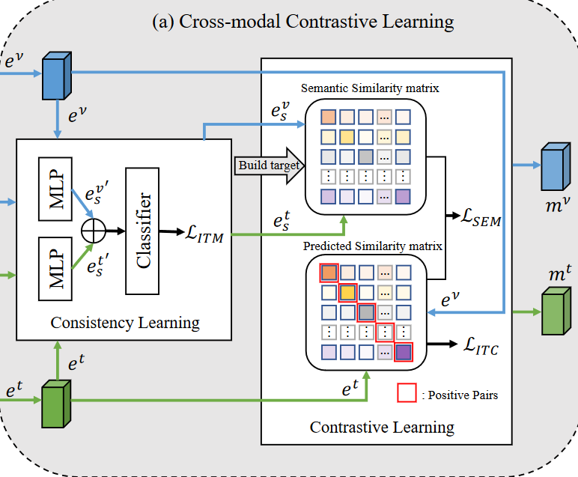
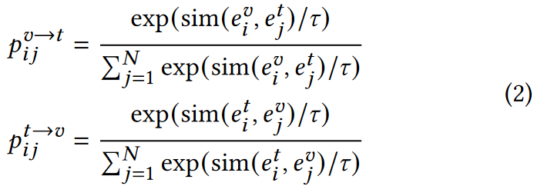
ATAI
Advanced Technique of
Artificial Intelligence
ATAI
ChongqingUniversity _{AdvancedTechniqueof}
of Technology Artificial Intelligence
Chongqing University of Technology
Method

Slide 5
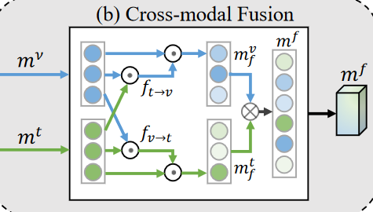
ATAI
Advanced Technique of
Artificial Intelligence
ATAI
ChongqingUniversity _{AdvancedTechniqueof}
of Technology Artificial Intelligence
Chongqing University of Technology
Method

Slide 6
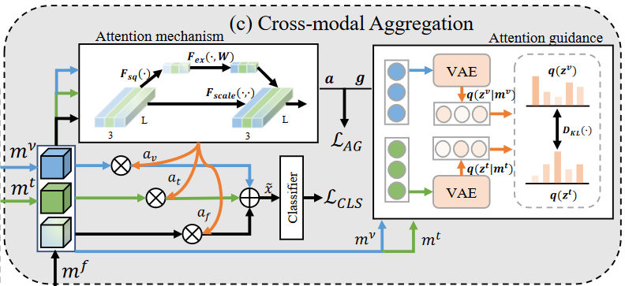
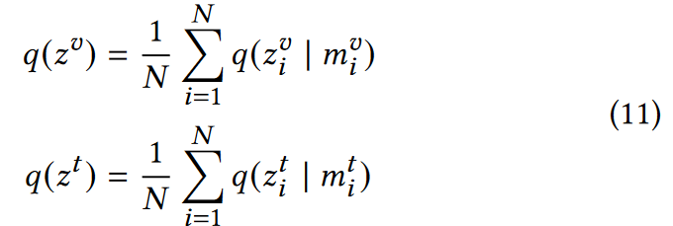
ATAI
Advanced Technique of
Artificial Intelligence
ATAI
ChongqingUniversity _{AdvancedTechniqueof}
of Technology Artificial Intelligence
Chongqing University of Technology
Method

Slide 7
ATAI
Advanced Technique of
Artificial Intelligence
ATAI
ChongqingUniversity _{AdvancedTechniqueof}
of Technology Artificial Intelligence
Chongqing University of Technology
Method

Slide 8
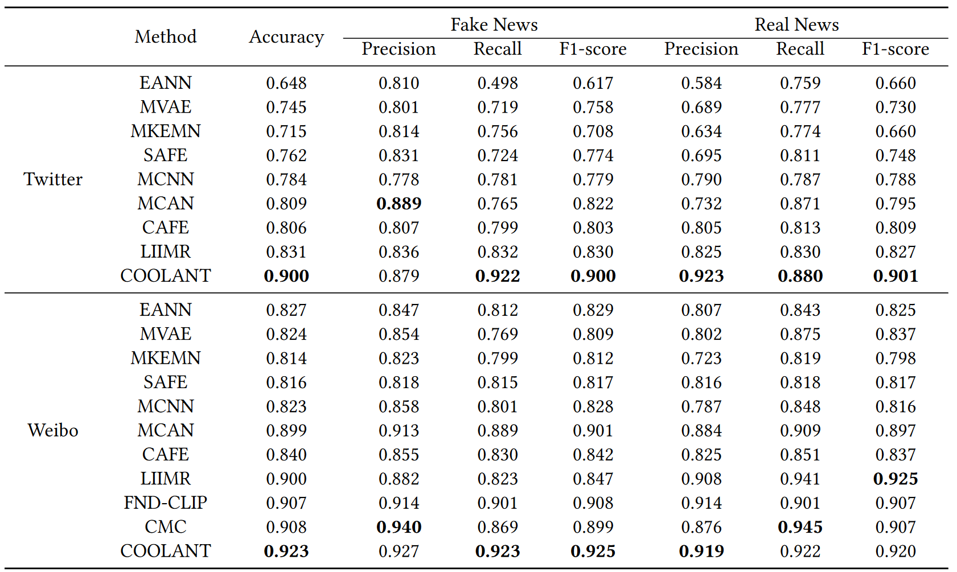
ATAI
Advanced Technique of
Artificial Intelligence
ATAI
ChongqingUniversity _{AdvancedTechniqueof}
of Technology Artificial Intelligence
Chongqing University of Technology
Experiments

Slide 9
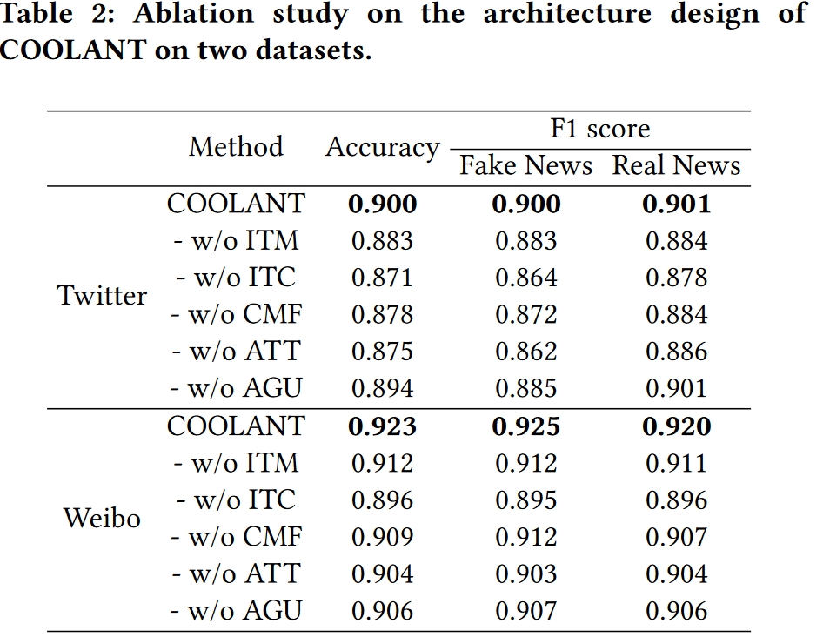
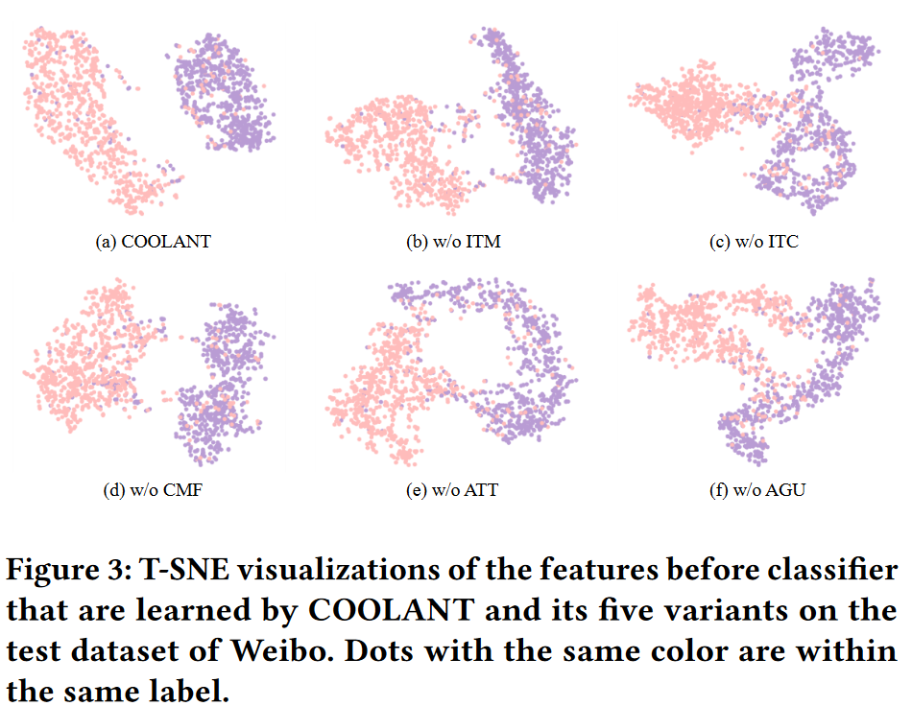
ATAI
Advanced Technique of
Artificial Intelligence
ATAI
ChongqingUniversity _{AdvancedTechniqueof}
of Technology Artificial Intelligence
Chongqing University of Technology
Experiments

Slide 10
ChongqingUniversity of Technology
ATAI
Advanced Technique of
Artificial Intelligence
ATAI
ChongqingUniversity _{AdvancedTechniqueof}
of Technology Artificial Intelligence
Chongqing University of Technology
Thanks!

